Slide 1
QA Hackfest
Team New Guinea
Tasdiq, Naym, Daniel

Slide 2
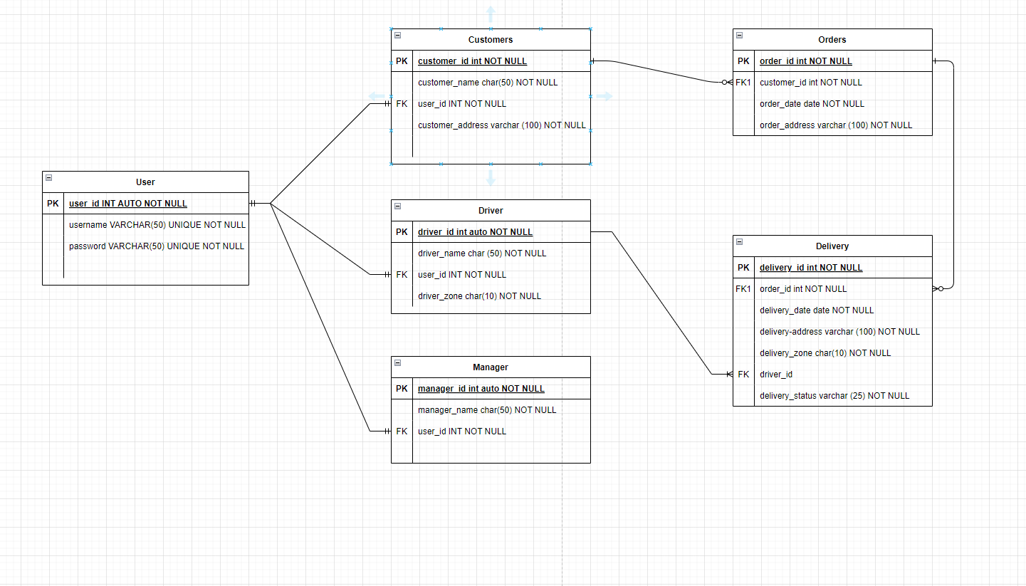
ERD

Slide 3
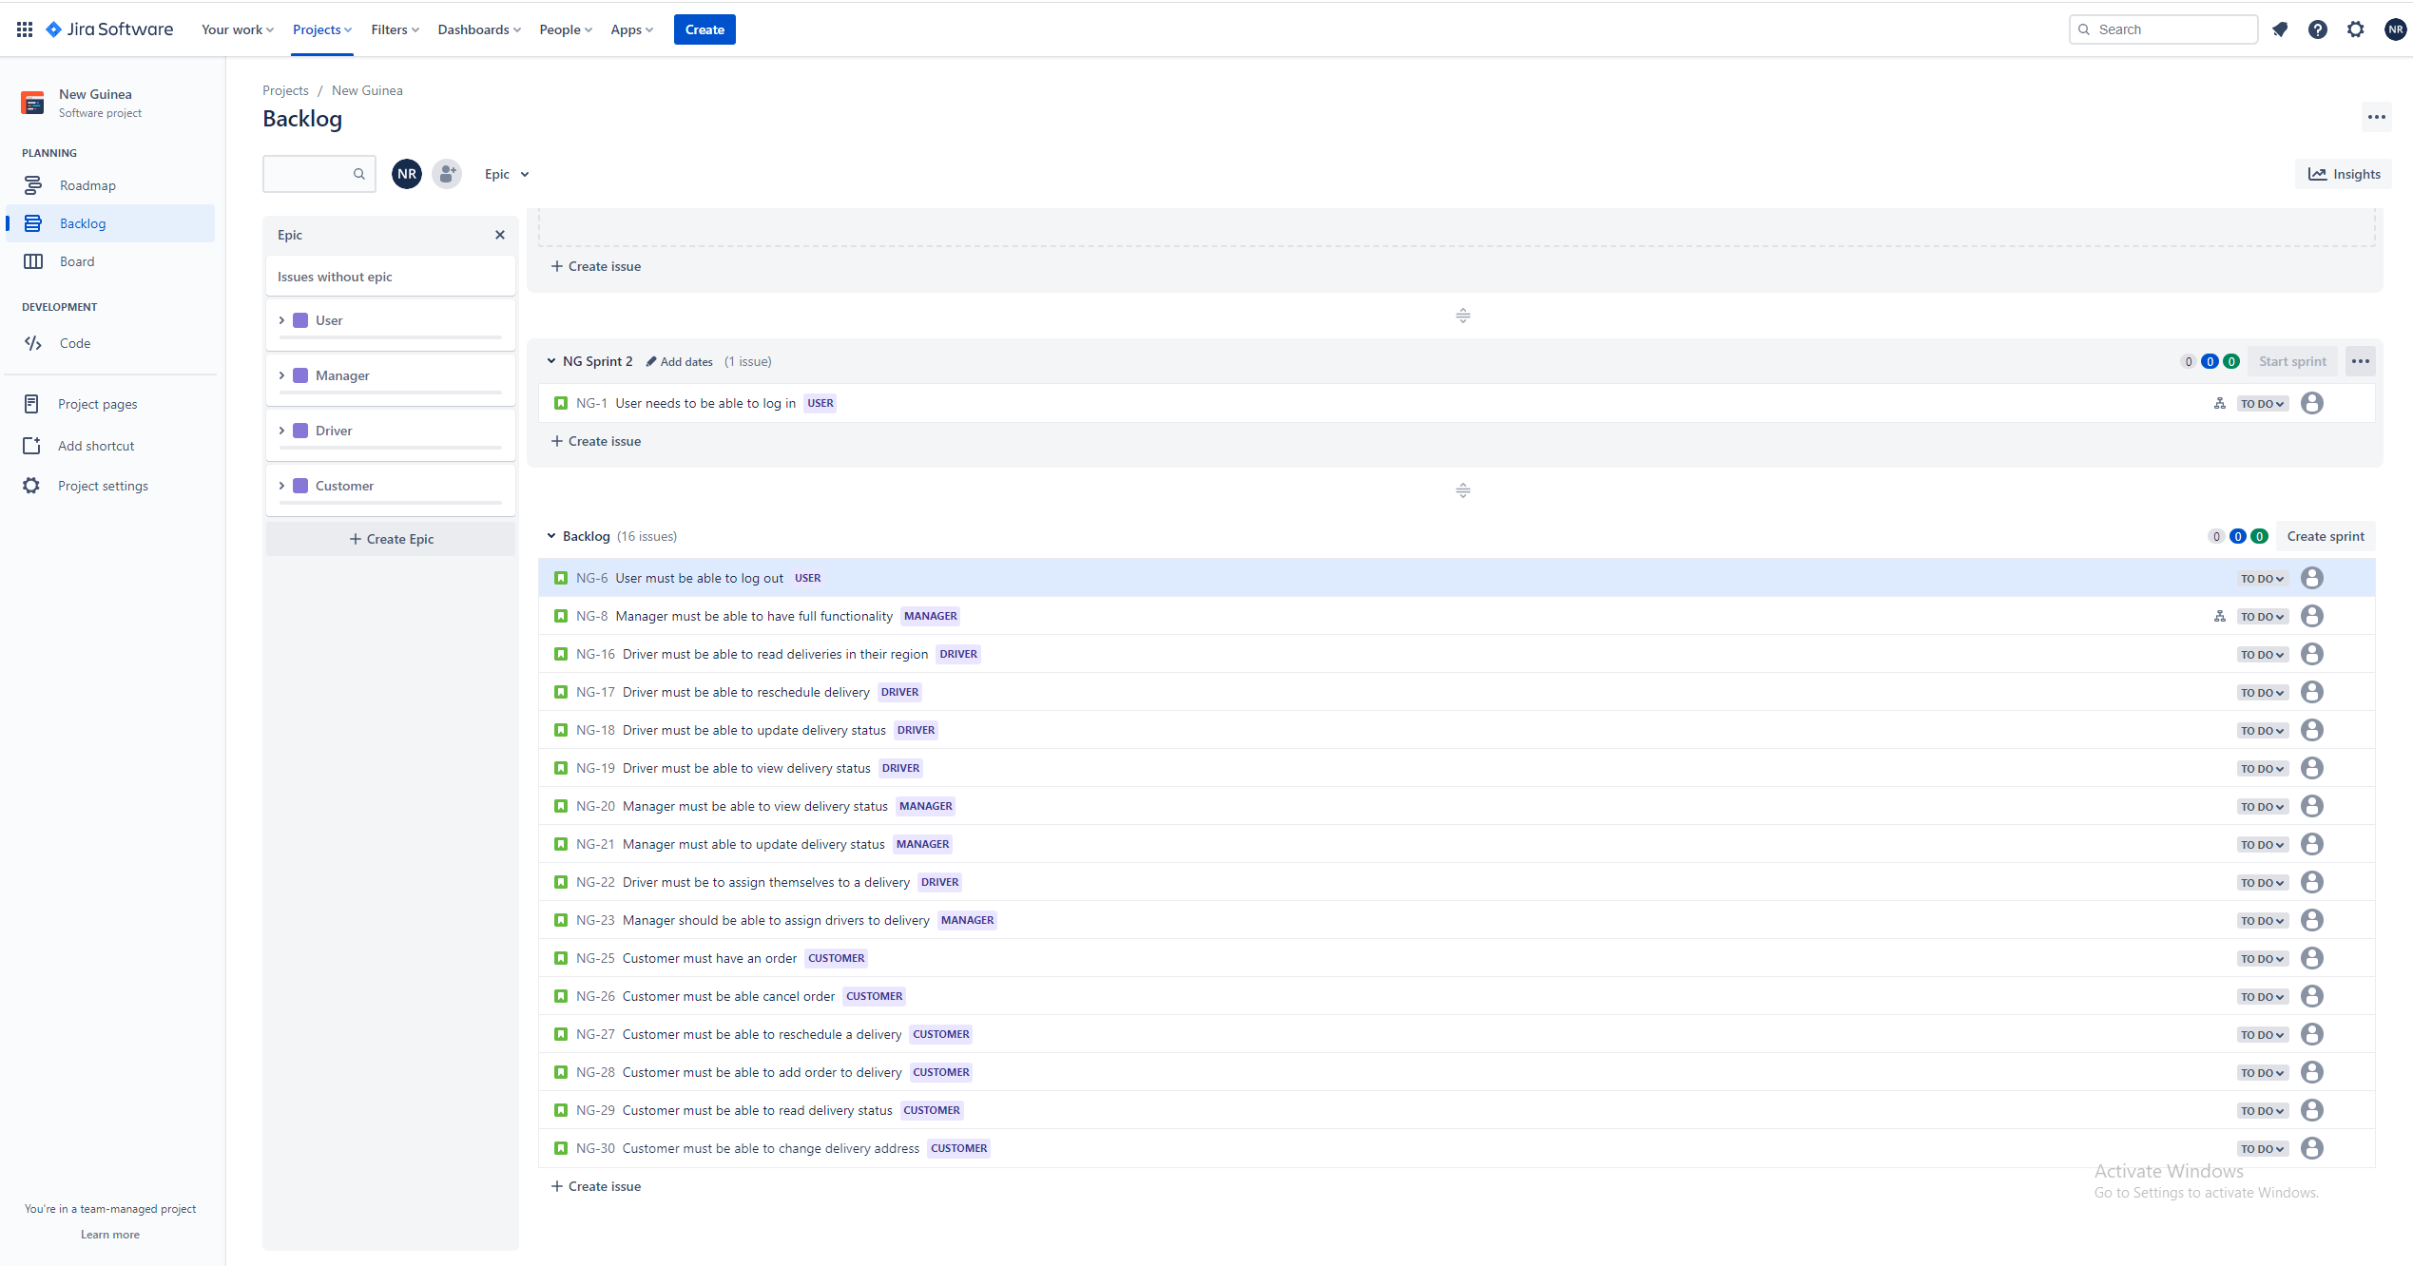
Jira Board

Slide 4
Collaboration
Tasdiq
Naym
Daniel
SQL
DAO
Controllers
Login system
Domains
Controllers
DAO
Domains
Controllers
Login system

Slide 5
Ideas
To build an uber eats style delivery system where orders and customers are created and assigned to deliveries.
Managers have full admin access.
Orders are sorted into delivery zones and then assigned to drivers who can read and update orders as necessary.

Slide 6
What went well
Worked well as a team and was able to get a working demo from a section of the codebase.
Brainstormed good ideas that led to a clear understanding of what each team member was working on.
Helped each other to get as much codebase completed as possible.

Slide 7
What didn’t go well
Project is not fully completed.

Slide 8
Code demo

